Slide 1
CS489 Project Sales Pitch Forus: A healthy debate platform
Team10 Inyong Koo, Minsu Kim

Slide 2


Technology leads back to tribalism
Friends and followers
“Beliefs and world-views are reinforced by repetition inside a closed network of similarly-minded people”
Difficult to meet opposing ideas
Often exposed to disrespectful comments
That’s why we need a new platform..
Where healthy discussion can be made,
A forum for us!

Slide 3
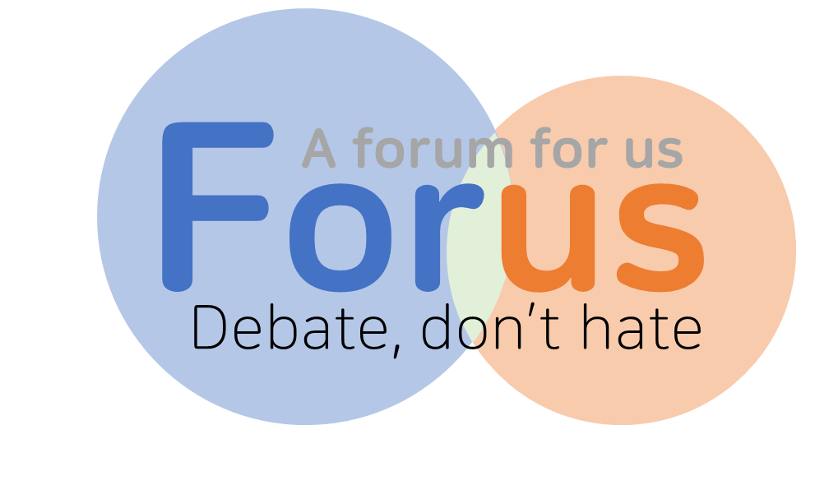
What is Forus?
Few Ground rules
Clean, swear-free debate
We don’t show polls
Make your side to participate
Read powerful opposing ideas and reassess your reasons
Give credit only to opponents
Notes:
We impose strict sanctions on swear words, disrespectful expressions and personal attacks

Slide 4
Topic Read This: Inmates in Finland are training AI as part of prison labor
Do you support the practice outlined in the article?
My opinion Cons
See Opinions
Topic “social networking and automated contents recommendation are
making people more radical”
My opinion Pros / Cons
See Opinions
General hot topics or individual recommendation feed
Personal timeline shows the topics user participated

Slide 5
Topic “social networking and automated contents recommendation are
making people more radical”
My opinion Pros / Cons
See Opinions
I agree with this statement because ~~
I disagree with this statement because ~~
43 Approves from Cons
Fair enough!
61 Approves from Pros
Fair enough!
You choose your side to add a new opinion.
You can vote approval but only opponent’s approvals are shown.
Notes:
Fair enough는 각 입장에 대해 논리적이라 생각하면 얼마든지 줄 수 있음. 찬반 중 하나를 선택할 경우 상대 진영의 의견에 대해서는 Approve로 count가 올라가나, 우리 진영에 대해서는 approve를 따로 표시하지 않음 (의견 올리는 순서에 대해서는 영향을 줄 수 있겠다.)

Slide 6
Topic “social networking and automated contents recommendation are
making people more radical”
My opinion Pros
See Opinions
My Opinion I believe ~~~
3 Approves from Cons
I disagree with this statement because ~~
62 Approves from Pros
Add Objection
Fair enough!
I don’t think this statement is true because ~~
37 Approves from Pros
Add Objection
Fair enough!
You are more exposed to opposing ideas
Notes:
Fair enough는 각 입장에 대해 논리적이라 생각하면 얼마든지 줄 수 있음. 찬반 중 하나를 선택할 경우 상대 진영의 의견에 대해서는 Approve로 count가 올라가나, 우리 진영에 대해서는 approve를 따로 표시하지 않음 (의견 올리는 순서에 대해서는 영향을 줄 수 있겠다.)

Slide 7

Profile
John Smith (Influence Level 9)
Advocates 226
Interested Topics
#Environment #Politics #Animals
#Philosophy #ComputerEthics
Get many opponent’s approval to get higher influence level.
Be one’s advocate and get his/her opinion on top of others
Set Interested topics to get recommendation

Slide 8
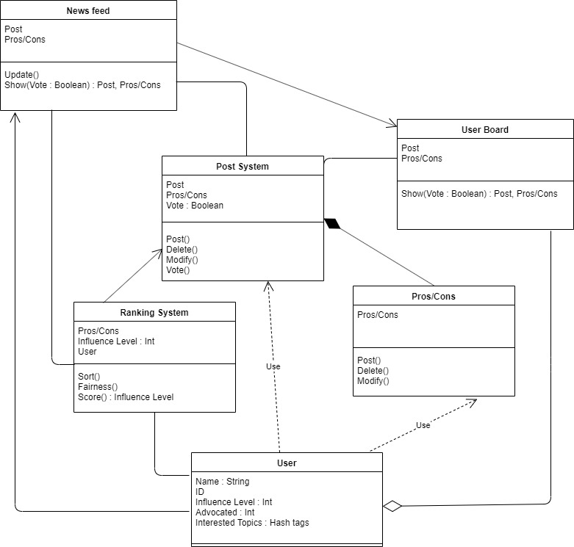
System Diagram
Functions
News feed : Typical Social network interface that shows global hot topics and recommended topics via user’s interest
User Board : Every user has this page. This page shows all participations, opinions and their objections
Post System : Main system that manages ethical issue posting. In this system, user can post issues or vote for another user’s issue. User can write their opinion (Pros or Cons) based on their vote.
Ranking System : This system provide opinions in order based on approvals and user’s influence level.

Slide 9
Expectation
When you write,
You carefully organize your logic and word choice
You establish your profile for recommendation and build influence level
When you read,
You meet different perspective on the topic
You can show appreciation for reasonable, persuasive opposing ideas
You develop a concrete moral with balanced view
You become a respectful debater
Thank you

